Slide 1
A Feast of Frameworks
Making your life easier by not reinventing the wheel

Slide 2
Practical information
We have one assignment which will be graded at the end of the course, upon submission
After each lesson, you will be able to implement a part of the assignment
We recommend to do it gradually
At the beginning of each lesson, we will do a "refresher" of the previous topic. Come with a smartphone
Each lesson includes some practice. Be here with a laptop and enough battery
Tooling:
VS Code or IntelliJ Idea
Java 21
Git
Setup everything by using the "cook-books" from oop-2: https://appliedmath.toi.inholland.nl/oop-2-code-projects/cook-books

Slide 3
Objectives
Get an understanding of common frameworks
Learn to incorporate frameworks in your application

Slide 4
Objectives
Code examples can be found here

Slide 5
What is a framework?
A foundational structure used to build software applications
A standard way to implement certain solutions in your code
Pre-coded implementations in the form of libraries and tools that you can use in your application

Slide 6

Why use a framework?
Don't reinvent the wheel
Fast
Secure
Community support
Frameworks and libraries can also contain threaths!
Notes:
Log4j!

Slide 7
Spring Framework
Modular framework for java applications
Key concepts:
Dependency injection
Inversion of Control through context management
Facilitates using other frameworks
Notes:
Spring core, spring web, spring boot, spring data, spring mvc (web) etc
Dependency injection is a design pattern where objects are given their dependencies instead of creating them themselves. This promotes loose coupling and easier testing.
Inversion of control: the ifecycle of objects is managed by the framework instead of the application. All objects are managed as “beans”. Spring does this by setting up an application context.

Slide 8
Spring Boot
Layer on top of Spring framework
Convention over configuration
Easier to configure than pure Spring framework
Annotations instead of xml
Automated configuration based on included dependencies
Built in support for
Logging
Metrics
Health checks
Simplifies testing with embedded servers

Slide 9
Spring MVC
Meant for web applications
Easy setup of controllers
Easy processing of HTTP requests

Slide 10
Model – View – Controller Architecture
Controller layer
Handles HTTP requests
Delegates processing to the service layer
Returns responses (usually in JSON)
Service layer
Contains the business logic
Bridge between controller and repository layers
Validation, transformation of data, orchestration logic

Slide 11
Model – View – Controller Architecture
Repository layer
Interacts with the database
Usually uses a framework for CRUD operations
Model layer
Represents domain objects (entities)
Usually set up with a framework
Controller layer
Handles user input
Returns the response

Slide 12
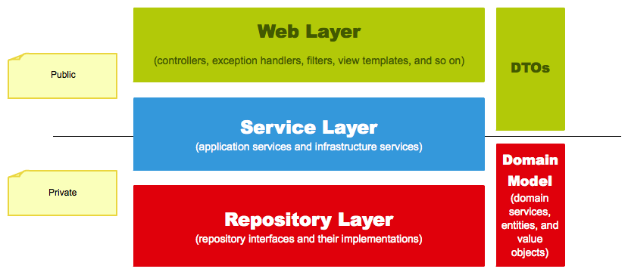
Model – View – Controller Architecture

Slide 13
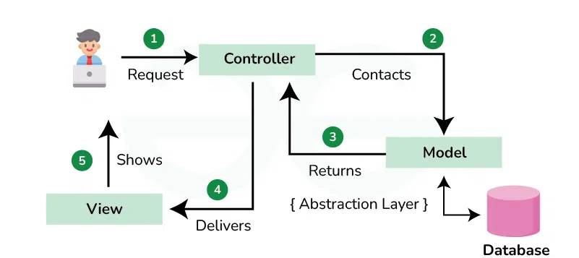
Flow

Slide 14
Aspect Oriented Programming
Aspect
Intercept
Usually it takes a big effort to implement, but if it’s provided by the framework, it’s easy and useful.
The purpose is to centralize cross cutting concerns, keeping other classes clean.
Intercepts method calls and can execute code before, after and/or on uncaught exceptions
Instance
Method call
Return
Uncaught exceptions

Slide 15




Aspect Oriented Programming Example
Statement statement1 = connection.createStatement();
Statement statement2 = connection.createStatement();
String sql1 = "INSERT INTO mytable (name, age) VALUES ('John',30)";
String sql2 = "INSERT INTO mytable (name, age) VALUES ('Jane',30)";
try {
statement1.executeUpdate(sql1);
statement2.executeUpdate(sql2);
connection.commit();
} catch (SQLException e) {
System.err.println("An error occurred: " + e);
connection.rollback();
} finally {
if (statement1 != null) {
statement1.close();
}
if (connection != null) {
connection.close();
}
}
@Transactional
public void savePeople(Person... people) {
for (Person person : people) {
peopleRepository.save(person);
}
}

Slide 16
Setting up an application
Start from scratch easily with Spring Initializr
Select the common dependencies you want to include
You can always add others later

Slide 17
Setting up an application
Application that stores a person, retrieves an image and saves the person in the database
Create the model(s)
Set up the repository
Create the service layer
Create the controller

Slide 18
Additional frameworks
Lombok
Generates boilerplate code
Common annotations for getter, setter, allArgsConstructor, builder
Spring JPA
Database connection
SQL statement creation
Example: Find Person by name

Slide 19
Adding I/O streams processing
The input from request is transformed into java objects
The response is written to the output stream in a similar way we did last week and sent to the client, but by the framework
The switch statement for the http methods is done for us by the framework, based on annotations
The URL in the request is already represented in a structured way, no need to handle strings to get query parameters, paths, etc.

Slide 20
Multithreading
Similar, but easier to manage the multithreading
Setup a multithreading configuration
Virtual threads require even less configuration

Slide 21
Error Handling with HTTP
When an exception is thrown, return a fitting error status
400 – Bad Request
403 – Forbidden
404 – Not Found
418 – I’m a teapot
Notes:
418 was introduces as an april fool’s joke, it is meant for teapots who are asked to brew coffee. It is sometimes used instead of 403

Slide 22
Homework
After each lesson, you get a piece of homework that serves as implementation of the final assignment.
After lesson 4, we can now refactor our applications to use frameworks.
Refactor your application to use frameworks. Suggested frameworks are Spring, Spring MVC, Spring JDBC

